Slide 1
Introduction to Network Security

Slide 2
Network Security
Network security consists of the policies and practices adopted to prevent and monitor unauthorized access, misuse, modification, or denial of a computer network and network-accessible resources.
Network security involves the authorization of access to data in a network, which is controlled by the network administrator.
“Network security is any activity designed to protect the usability and integrity of your network and data. It includes both hardware and software technologies. Effective network security manages access to the network. It targets a variety of threats and stops them from entering or spreading on your network.” - Cisco

Slide 3
Network Security Fundamentals
Keep patches and update current versions
Use strong passwords
Don’t use any words from the dictionary
Don’t use anything related to your name, nickname, family members or pets
Don’t use any numbers someone could guess by looking at your mail like phone numbers and street numbers
Choose a phrase that means something to you, take the first letters of each word and convert some into characters.
Secure your VPN
Actively manage user privileges
Cleanup inactive accounts

Slide 4
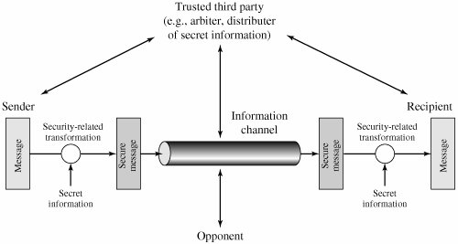
Model for Network Security

Slide 5
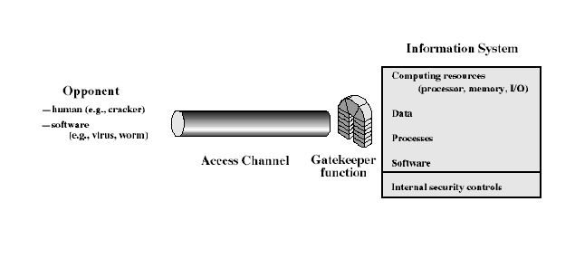
Network Access Security Model

Slide 6
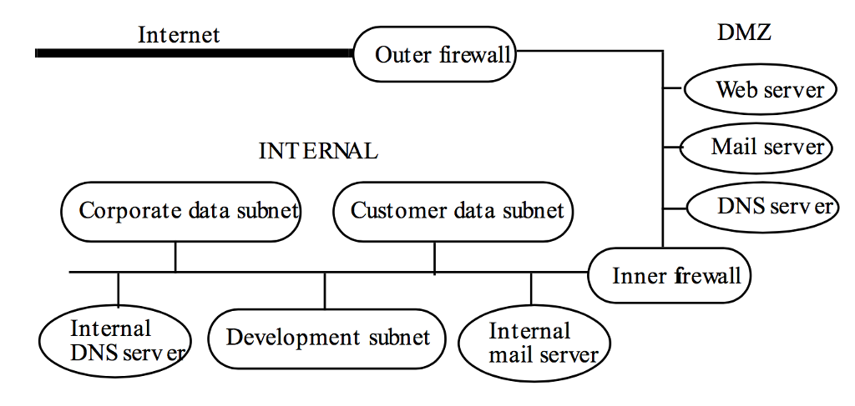
Network Organization

Slide 7
Principal methods of protecting Network:
(Encryption, Decryption, Encryption in network)
Network encryption is the process of encrypting or encoding data and messages transmitted or communicated over a computer network.
It is a broad process that includes various tools, techniques and standards to ensure that the messages are unreadable when in transit between two or more network nodes.

Slide 8
Network encryption is primarily implemented on the network layer of the OSI model.
Network encryption implements one or more encryption algorithms, processes and standards to encrypt the data/message/packet sent over the network.
The encryption services are generally provided by encryption software or through an integrated encryption algorithm on network devices and/or in software.

Slide 9
On an IP-based network, network encryption is implemented through Internet Protocol Security (IPSec)-based encryption techniques and standards.
Each message sent is in an encrypted form and is decrypted and converted back into plain text/original form at the recipient's end using encryption/decryption keys.
Using the existing network services and application software, network encryption is invisible to the end user and operates independently of any other encryption processes used.

Slide 10
Data is encrypted only while in transit, existing as plaintext on the originating and receiving hosts.
Network encryption products and services are offered by a number of companies, such as Cisco.

Slide 11
Firewalls and Proxies
A firewall is a host that mediates access to a network, allowing and disallowing certain types of access on the basis of a configured security policy.
A firewall is a network security system that monitors and controls incoming and outgoing network traffic based on predetermined security rules.
A firewall typically establishes a barrier between a trusted internal network and untrusted external network, such as the Internet.

Slide 12
Firewall accepts or rejects messages on the basis of external information rather than on the basis of the contents of the message.
A filtering firewall performs access control on the basis of attributes of the packet headers, such as destination addresses, source addresses, and options.
Routers and other infrastructure systems are typical examples of filtering firewalls.
They allow connections through the firewall, usually on the basis of source and destination addresses and ports.

Slide 13
This contrasts with the second type of firewall, which never allows such a direct connection. Instead, special agents called proxies control the flow of information through the firewall.
A proxy is an intermediate agent or server that acts on behalf of an endpoint without allowing a direct connection between the two endpoints.
A proxy (or applications level) firewall uses proxies to perform access control.
A proxy firewall can base access control on the contents of packets and messages, as well as on attributes of the packet headers.

Slide 14
A proxy firewall adds to a filtering firewall the ability to base access on content, either at the packet level or at a higher level of abstraction.
A different point of view is to see the firewall as an audit mechanism.
It analyzes the packets that enter. Firewalls can then base actions on this analysis, leading to traffic shaping (in which percentages of bandwidth are reserved for specific types of traffic), intrusion response, and other controls.

Slide 15
Demilitarized Zone (DMZ)
In computer networks, a DMZ (demilitarized zone) is a physical or logical sub-network that separates an internal local area network (LAN) from other untrusted networks, usually the Internet.
External-facing servers, resources and services are located in the DMZ so they are accessible from the Internet but the rest of the internal LAN remains unreachable.
A DMZ is now often referred to as a perimeter network.

Slide 16
This provides an additional layer of security to the LAN as it restricts the ability of hackers to directly access internal servers and data via the Internet.
Any service that is being provided to users on the Internet should be placed in the DMZ.
The most common of these services are: Web, Mail, DNS, FTP, and VoIP.
The term DMZ comes from the geographic buffer zone that was set up between North Korea and South Korea at the end of the Korean War.

Slide 17
There are various ways to design a network with a DMZ. The two most common methods are with a single or dual firewalls as shown in the figure.
A single firewall with at least three network interfaces can be used to create a network architecture containing a DMZ. The external network is formed from the ISP to the firewall on the first network interface, the DMZ is formed from the second network interface and the internal network is formed from the third network interface.

Slide 18
Different sets of firewall rules for traffic between the Internet and the DMZ, the LAN and the DMZ, and the LAN and the Internet tightly control which ports and types of traffic are allowed into the DMZ from the Internet, limit connectivity to specific hosts in the internal network, and prevent unrequested connections either to the Internet or the internal LAN from the DMZ.

Slide 19
A more secure approach is to use two firewalls to create a DMZ.
The first firewall also called the perimeter firewall is configured to allow traffic destined to the DMZ only.
The second or internal firewall only allows traffic from the DMZ to the internal network.
This is considered more secure since two devices would need to be compromised before an attacker could access the internal LAN.

Slide 20
For example, a network intrusion detection and prevention system located in a DMZ that only contains as Web server can block all traffic except HTTP and HTTPS requests on ports 80 and 443.

Slide 21
Analysis of Network Infrastructure:
The security policy distinguishes “public” entities from those internal to the corporation, but recognizes that some corporate resources must be available to the public.
The public entities may enter the corporate perimeter (bounded by the “outer firewall”) but are confined to the DMZ area (bounded inside by the “inner firewall”).
The key decision is to limit the flow of information from the internal network to the DMZ.

Slide 22
The public cannot communicate directly with any system in the internal network, nor can any system in the internal network communicate directly with other systems on the Internet (beyond the “outer firewall”).
The systems in the DMZ serve as mediators, with the firewalls providing the guards.
The firewalls and the DMZ systems control all access to and from the Internet and filter all traffic in both directions.

Slide 23
The first step is to hide the addresses of the internal network.
In general, the internal network addresses can be any IP addresses, and the inner firewall can use a protocol such as the Network Address Translation protocol to map these internal host addresses to the firewall’s Internet address.
A more common method is to assign each host an address but not allow those addresses to leave the corporate network.

Slide 24
All services are implemented as proxies in the outer firewall. However, electronic mail presents a special problem.
The DMZ mail server must know an address in order for the internal mail server to pass mail back and forth.
This need not be the actual address of the internal mail server. It could be a distinguished address that the inner firewall will recognize as representing the internal mail server.

Slide 25
Similarly, the internal mail server must know an address for the DMZ mail server. These addresses can be fixed (in which case the DMZ DNS server is unnecessary).
The Web server lies in the DMZ for the same reasons that a mail server lies in the DMZ. External connections to the Web server go into the DMZ and no farther.
If any information is to be transmitted from the Web server to the internal network (for example, the customer data subnet), the transmission is made separately, and not as part of a Web transaction.

Slide 26
The goals of the outer firewall are to restrict public access to the Drib’s corporate network and to restrict the Drib’s access to the Internet. This arises from the duality of information flow.
In the Bell-LaPadula Model, for example, one cannot read information from a higher level (here, by restricting public access to the Drib’s network), but one cannot write information to a lower level, either (here, by restricting the Drib’s employees’ access to the Internet).

Slide 27
To implement the required access control, the firewall uses an access control list, which binds source addresses and ports and destination addresses and ports to access rights.
The public needs to be able to access the Web server and mail server, and no other services. The firewall therefore presents an interface that allows connections to the WWW services (HTTP and HTTPS) and to electronic mail (SMTP).

Slide 28
Sites on the Internet see the addresses of the Web and mail servers as the same—that of the firewall. No other services are provided to sites on the Internet.
The firewall is a proxy-based firewall. When an electronic mail connection is initiated, the SMTP proxy on the firewall collects the mail. It then analyzes it for computer viruses and other forms of malicious logic. If none is found, it forwards the mail to the DMZ mail server.

Slide 29
When a Web connection (or datagram) arrives, the firewall scans the message for any suspicious components (such as extraordinarily long lines or other evidence of attacks) and, if none is found, forwards it to the DMZ Web server.
These two DMZ servers have different addresses, neither of which is the address of the firewall.
Attackers trying to penetrate the firewall have three methods of entry.
The first is to enter through the Web server ports.

Slide 30
The unsecured (HTTP) port proxy checks for invalid or illegal HTTP requests and rejects them.
The second is to enter through the SMTP port.
The mail proxy will detect and reject such attempts.
The third is to attempt to bypass the low-level firewall checks by exploiting vulnerabilities in the firewall itself.

Slide 31
The internal network is where the Drib’s most sensitive data resides.
It may contain data, such as proprietary information, that the Drib does not want outsiders to see.
For this reason, the inner firewall will block all traffic except for that specifically authorized to enter.
All such information will come from the DMZ, and never directly from the Internet.

Slide 32
Like the outer firewall, the inner firewall allows a limited set of traffic through (using the same type of access control mechanism as does the outer firewall).
It allows SMTP connections using proxies, but all electronic mail is sent to the DMZ mail server for disposition.
It allows limited transfer of information to the DNS server in the DMZ.
It also allows system administrators to access the systems in the DMZ from a trusted administrative server. All other traffic, including Web access, is blocked.

Slide 33
The Mail server in the DMZ performs address and content checking on all electronic mail messages.
The goal is to hide internal information from the outside while being transparent to the inside.
The Web server accepts and services requests from the Internet. It does not contact any servers or information sources within the internal network.
This means that if the Web server is compromised, the compromise cannot affect internal hosts.

Slide 34
The DMZ DNS host contains directory name service information about those hosts that the DMZ servers must know.
It contains entries for the following.
• DMZ mail, Web hosts
• Internal trusted administrative host
• Outer firewall
• Inner firewall

Slide 35
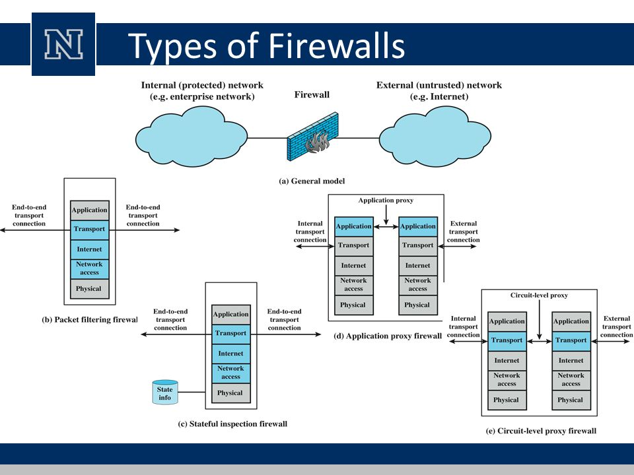
Types of Firewalls

Slide 36
Packet filtering firewall:
A packet filtering firewall applies a set of rules to each incoming and outgoing IP packet and then forwards or discards the packet
The firewall is typically configured to filter packets going in both directions (from and to the internal network).
Filtering rules are based on information contained in a network packet.

Slide 37
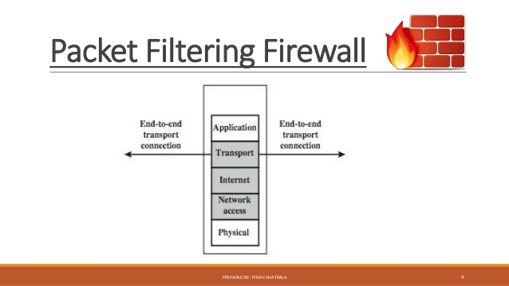

Slide 38
Source IP address: The IP address of the system that originated the IP packet (e.g., 192.178.1.1)
Destination IP address: The IP address of the system the IP packet is trying to reach (e.g., 192.168.1.2)
Source and destination transport-level address: The transport-level (e.g., TCP or UDP) port number, which defines applications such as SNMP or TELNET
IP protocol field: Defines the transport protocol.

Slide 39
Interface: For a firewall with three or more ports, which interface of the firewall the packet came from or which interface of the firewall the packet is destined for.
The packet filter is typically set up as a list of rules based on matches to fields in the IP or TCP header.
If there is a match to one of the rules, that rule is invoked to determine whether to forward or discard the packet. If there is no match to any rule, then a default action is taken.

Slide 40
Two default policies are possible:
Default = discard: That which is not expressly permitted is prohibited.
Default = forward: That which is not expressly prohibited is permitted.
Advantage of a packet filtering firewall is its simplicity. Also, packet filters typically are transparent to users and are very fast.
Because packet filter firewalls do not examine upper-layer data, they cannot prevent attacks that employ application-specific vulnerabilities or functions.

Slide 41
State-full packet filtering
State-full packet filtering is a firewall technology that monitors the state of active connections and uses this information to determine which network packets to allow through the firewall.
It is also known as dynamic packet filtering and Stateful inspection filtering.
Only packets matching a known active connection are allowed to pass the firewall.
It is a security feature often included in business networks.

Slide 42
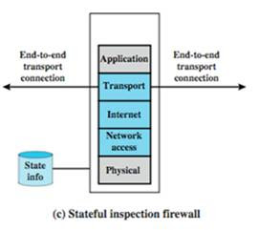

Slide 43
A stateful inspection packet firewall tightens up the rules for TCP traffic by creating a directory of outbound TCP connections.
There is an entry for each currently established connection.
The packet filter will now allow incoming traffic to high-numbered ports only for those packets that fit the profile of one of the entries in this directory.

Slide 44
By recording session information such as IP addresses and port numbers, a dynamic packet filter can implement a much tighter security posture than a static packet filter can.
In a firewall that uses stateful inspection, the network administrator can set the parameters to meet specific needs.
In a typical network, ports are closed unless an incoming packet requests connection to a specific port and then only that port is opened.
This practice prevents port scanning, a well-known hacking technique.

Slide 45
Application Level Gateway
An application-level gateway, also called an application proxy, acts as a relay of application-level traffic.
The user contacts the gateway using a TCP/IP application, such as Telnet or FTP, and the gateway asks the user for the name of the remote host to be accessed.
When the user responds and provides a valid user ID and authentication information, the gateway contacts the application on the remote host and relays TCP segments containing the application data between the two endpoints.

Slide 46
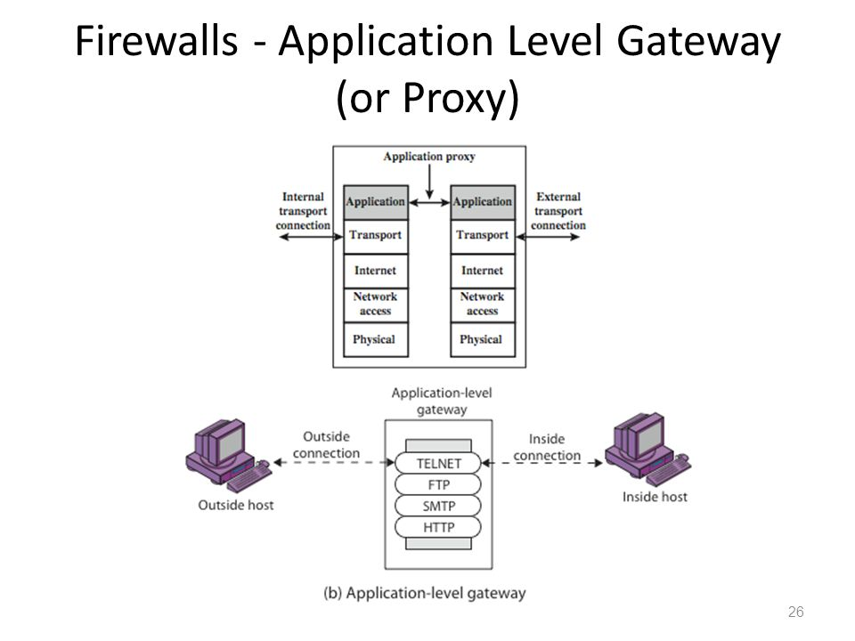

Slide 47
If the gateway does not implement the proxy code for a specific application, the service is not supported and cannot be forwarded across the firewall.
Application proxy filters incoming node traffic to certain specifications which mean that only transmitted network application data is filtered.
Application-level gateways tend to be more secure than packet filters.
In addition, it is easy to log and audit all incoming traffic at the application level.

Slide 48
Rather than trying to deal with the numerous possible combinations that are to be allowed and forbidden at the TCP and IP level, the application-level gateway need only examine a few allowable applications.
A prime disadvantage of this type of gateway is the additional processing overhead on each connection.
In effect, there are two spliced connections between the end users, with the gateway at the splice point, and the gateway must examine and forward all traffic in both directions.

Slide 49
Circuit Level Gateway
A fourth type of firewall is the circuit-level gateway or circuit-level proxy.
The circuit level gateway firewalls work at the transport and session layer of the OSI model. They monitor TCP handshaking between the packets to determine if a requested session is legitimate.
As with an application gateway, a circuit-level gateway does not permit an end-to-end TCP connection; rather, the gateway sets up two TCP connections, one between itself and a TCP user on an inner host and one between itself and a TCP user on an outside host.

Slide 50
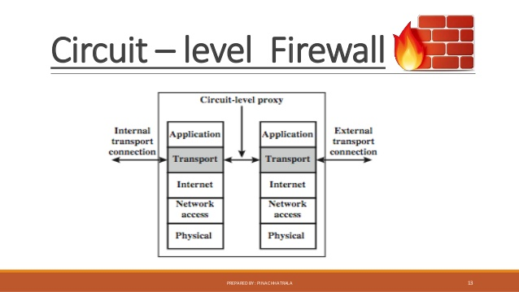

Slide 51
Once the two connections are established, the gateway typically relays TCP segments from one connection to the other without examining the contents.
The security function consists of determining which connections will be allowed.
A typical use of circuit-level gateways is a situation in which the system administrator trusts the internal users.

Slide 52
The gateway can be configured to support application-level or proxy service on inbound connections and circuit-level functions for outbound connections.
In this configuration, the gateway can suffer the processing overhead of examining incoming application data for forbidden functions but does not suffer from that overhead on outgoing data.

Slide 53
Internet Protocol Security(IPSec)
Internet Protocol Security (IPsec) is a network protocol suite that authenticates and encrypts the packets of data sent over a network.
Internet protocol security (IPsec) is a set of protocols that provides security for Internet Protocol. It can use cryptography to provide security.
IPsec can be used for the setting up of virtual private networks (VPNs) in a secure manner.

Slide 54
IPsec involves two security services:
Authentication Header (AH): This authenticates the sender and it discovers any changes in data during transmission.
Encapsulating Security Payload (ESP): This not only performs authentication for the sender but also encrypts the data being sent.
IPsec can protect data flows between a pair of hosts (host-to-host), between a pair of security gateways (network-to-network), or between a security gateway and a host (network-to-host).

Slide 55
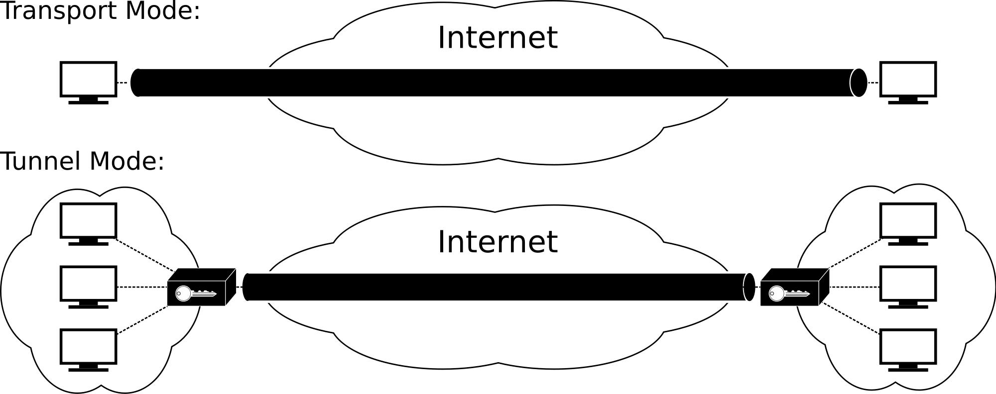
There are two modes of Ipsec as shown in figure:

Slide 56
Tunnel Mode: This will take the whole IP packet to form secure communication between two places, or gateways.
Transport Mode: This only encapsulates the IP payload (not the entire IP packet as in tunnel mode) to ensure a secure channel of communication.

Slide 57
Virtual Private Network (VPN)
A virtual private network extends a private network across a public network, and enables users to send and receive data across shared or public networks as if their computing devices were directly connected to the private network.
Applications running across a VPN may therefore benefit from the functionality, security, and management of the private network.

Slide 58
A VPN consists of a set of computers that interconnect by means of a relatively unsecure network and that make use of encryption and special protocols to provide security.
At each corporate site, workstations, servers, and databases are linked by one or more local area networks (LANs).
The Internet or some other public network can be used to interconnect sites, providing a cost savings over the use of a private network and offloading the wide area network management task to the public network provider.

Slide 59
That same public network provides an access path for telecommuters and other mobile employees to log on to corporate systems from remote sites.
A fundamental requirement for VPN is security.
Use of a public network exposes corporate traffic to eavesdropping and provides an entry point for unauthorized users.
To counter this problem, a VPN is needed. In essence, a VPN uses encryption and authentication in the lower protocol layers to provide a secure connection through an otherwise insecure network, typically the Internet.

Slide 60
VPNs are generally cheaper than real private networks using private lines but rely on having the same encryption and authentication system at both ends.
The encryption may be performed by firewall software or possibly by routers.
The most common protocol mechanism used for this purpose is at the IP level and is known as Ipsec.
An organization maintains LANs at dispersed locations.
A logical means of implementing an IPsec is in a firewall which is shown in the figure.

Slide 61
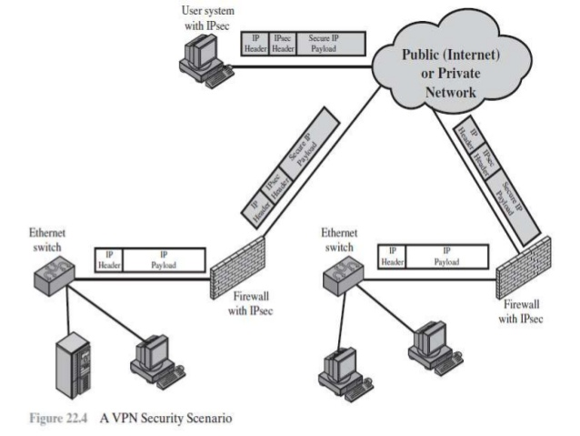

Slide 62
If IPsec is implemented in a separate box behind (internal to) the firewall, then VPN traffic passing through the firewall in both directions is encrypted.
In this case, the firewall is unable to perform its filtering function or other security functions, such as access control, logging, or scanning for viruses.
IPsec could be implemented in the boundary router, outside the firewall.
However, this device is likely to be less secure than the firewall and thus less desirable as an IPsec platform.

Slide 63
OSI Layer
Yourself

Slide 64
Types of Network Security
Access Control
Antivirus and Antimalware Software
• Application Security
• Behavioral analytics to detect abnormal network behavior
• Email Security, Web Security
• Data loss prevention
• Firewalls
• Intrusion prevention and detection system
• Virtual Private Networks (VPN)

Slide 65
Link and End-to-End Protocols
Let hosts C₀, …, C_{n} be such that C_{i} and C_{i+1} are directly connected, for 0 ≤ i < n.
A communications protocol that has C₀ and C_{n} as its endpoints is called an end-to-end protocol.
A communications protocol that has C_{j} and C_{j+1} as its endpoints is called a link protocol.

Slide 66
Link and End-to End Encryption
Each host enciphers message and “next hop” host can read it i.e. intermediate hosts can read the message in Link Encryption
Host enciphers message so host at other end of communication can read it i.e. message cannot be read at intermediate hosts in E2E

Slide 67
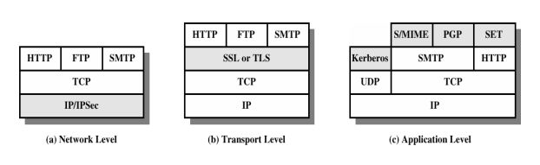
Security at Different Layers

Slide 68
At Application Layer - EMAIL
Pretty Good Privacy (PGP)
PGP is a public key encryption package to protect e-mail and data files.
It lets you communicate securely with people you've never met, with no secure channels needed for prior exchange of keys.
It's well featured and fast, with sophisticated key management, digital signatures, data compression, and good ergonomic design.

Slide 69
The actual operation of PGP is based on five services:
authentication, confidentiality, compression, e-mail compatibility, and segmentation.
PGP provides authentication via a digital signature scheme.
PGP provides confidentiality by encrypting messages before transmission
PGP compresses the message after applying the signature and before encryption

Slide 70
At Sender Side,
The e-mail message is hashed by using a hashing function to create a digest.
The digest is then encrypted to form a signed digest by using the sender's private key, and then signed digest is added to the original email message.
The original message and signed digest are encrypted by using a one-time secret key created by the sender.
The secret key is encrypted by using a receiver's public key.
Both the encrypted secret key and the encrypted combination of message and digest are sent together

Slide 71
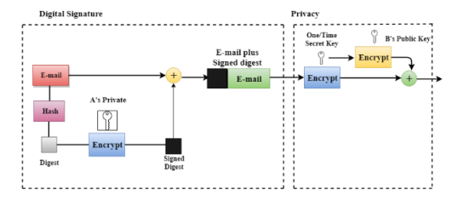

Slide 72
At Receiver Side,
The receiver receives the combination of encrypted secret key and message digest is received.
The encrypted secret key is decrypted by using the sender's private key to get the one-time secret key.
The secret key is then used to decrypt the combination of message and digest.
The digest is decrypted by using the sender's public key, and the original message is hashed by using a hash function to create a digest.
Both the digests are compared if both of them are equal means that all the aspects of security are preserved.

Slide 73
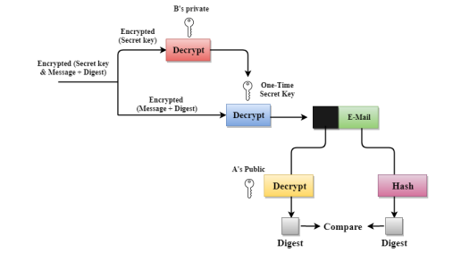

Slide 74
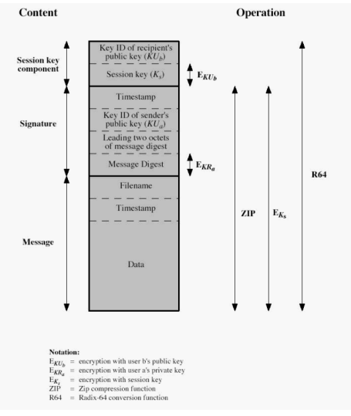

Slide 75
Privacy Enhanced Mail (PEM)
The U (user agent) interacts directly with the sender.
When the message is composed, the U hands it to the MT (message transport, or transfer, agent).
The MT transfers the message to its destination host, or to another MT, which in turn transfers the message further.
At the destination host, the MT invokes a user agent to deliver the message.

Slide 76
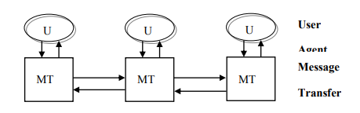

Slide 77
PEM vs PGP
Use of different ciphers: PGP uses IDEA cipher but PEM uses DES in CBC mode.
Use of certificate models: PGP uses general “web of trust” but PEM uses hierarchical certification structure.
Handling end of line: PGP remaps end of line if message tagged “text”, but leaves them alone if message tagged “binary” whereas PEM always remaps end of line.

Slide 78
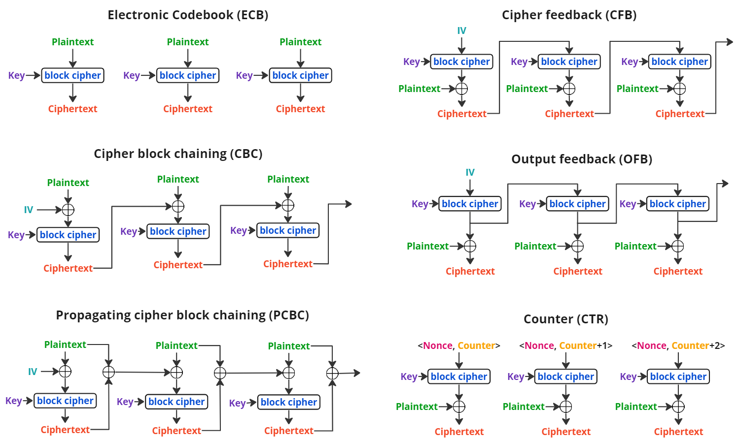

Slide 79
At Network Layer - IPSec
IPSec is a suite of authentication and encryption protocols developed by the Internet Engineering.
Task Force (IETF) and designed to address the inherent lack of security for IP-based networks.
It is a collection of protocols and mechanisms that provide confidentiality, authentication, message integrity, and replay detection at the IP layer.
In the data transmission IPsec protect all messages sent along a path.
If the IPsec mechanisms reside on an intermediate host (for example, a firewall or gateway), that host is called a security gateway

Slide 80
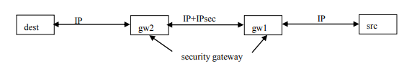

Slide 81
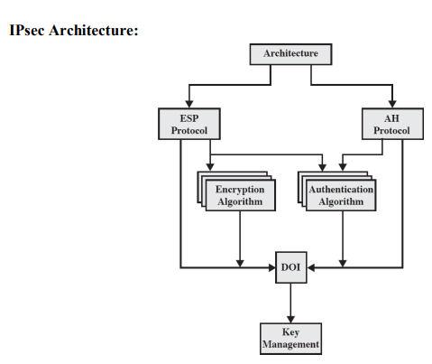

Slide 82
Encapsulating Security Payload (ESP) - Covers packet format and general issues related to the use of the ESP for packet encryption and, optionally, authentication.
Authentication Header (AH)- Covers the packet format and general issues related to the use of AH for packet authentication.
Encryption Algorithm- A set of documents that describe how various encryption algorithm are used for ESP.
Authentication Algorithm- A set of documents that describe how various authentication algorithms are used for AH and for authentication option of ESP.

Slide 83
Key Management- Documents that describe key management schemes.
Domain of Interpretation (DOI)- Contains the values needed for the other documents to relate to each other. These include identifiers for approved encryption and authentication algorithms, as well as operational parameters such as key lifetimes.
Security Policy Database (SPD)- IPSec use SPD that says how to handle messages (discard, add security services, forward message unchanged). The action taken depends on information in the IP and transport layer headers. IPsec determine the security services needed on the basis of the SPD and the packet‘s path.

Slide 84
When a packet arrives, the Ipsec consults the SPD for the relevant network interface. The SPD determines which entry applies on the basis of the attributes of the packet. These attributes include the source and destination port and address, the transport layer protocol involved, and other data.
Example
Goals: Discard SMTP packets from host 192.168.2.9 and forward packets from 192.168.19.7 without change SPD
Entries: are scanned in order and if no match for packet is found, it is discarded.
src 192.168.2.9, dest 10.1.2.3 to 10.1.2.103, port 25, discard;
src 192.168.19.7, dest 10.1.2.3 to 10.1.2.103, port 25, bypass;
dest 10.1.2.3 to 10.1.2.103, port 25, apply IPsec

Slide 85
AH Protocol
ESP Protocol
Yourself !

Slide 86
At Transport Layer – Secured Socket Layer (SSL)
Secure Sockets Layer (SSL) is a standard protocol used for the secure transmission of documents over a network.
Developed by Netscape, SSL technology creates a secure link between a Web server and browser to ensure private and integral data transmission.
SSL uses Transport Control Protocol (TCP) for communication.
In SSL, the word socket refers to the mechanism of transferring data between a client and server over a network.

Slide 87
When using SSL for secure Internet transactions, a Web server needs an SSL certificate to establish a secure SSL connection.
SSL encrypts network connection segments above the transport layer.
SSL follows an asymmetric cryptographic mechanism, in which a Web browser creates a public key and a private (secret) key.
The public key is placed in a data file known as a certificate signing request (CSR).
The private key is issued to the recipient only.

Slide 88
Objectives of SSL
Data integrity: Data is protected from tampering.
Data privacy: Data privacy is ensured through a series of protocols, including the SSL Record Protocol, SSL Handshake Protocol, SSL Change Cipher Spec Protocol and SSL Alert Protocol.
Client-server authentication: The SSL protocol uses standard cryptographic techniques to authenticate the client and server.

Slide 89
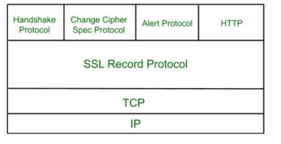

Slide 90
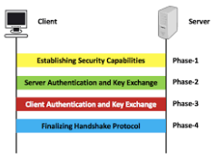
Handshake Protocol
Handshake Protocol is used to establish sessions.
This protocol allows client and server to authenticate each other by sending a series of messages to each other.
Handshake protocol uses four phases to complete its cycle.

Slide 91

Cipher Spec Protocol
This protocol uses SSL record protocol.
Unless Handshake Protocol is completed, the SSL record Output will be in pending state.
After handshake protocol the Pending state is converted into Current state.
Change-cipher protocol consists of single message which is 1 byte in length and can have only one value.
This protocol purpose is to cause the pending state to be copied into current state.

Slide 92
Alert Protocol
The Alert Protocol is used to convey TLS-related alerts to the peer entity.
As with other applications that use TLS, alert messages are compressed and encrypted, as specified by the current state.

Slide 93
Information Security
Processes and methodologies involved in protecting information and information systems from unauthorized access, use, disclosure, disruption, modification, or destruction.
Key Objectives: CIA Triad
Example Threats: Data breaches, insider threats, information leakage.

Slide 94
Component of Information Security
Access Controls
Cryptography
Security Policies
Risk Management
Incident Response

Slide 95
Cyber Security
Protection of internet-connected systems, including hardware, software, and data, from cyberattacks.
Key Objectives: Protecting against unauthorized access, attacks, damage, or data theft.
Example Threats: Phishing, ransomware, malware, DDoS attacks.

Slide 96
Components of Cyber Security
Application Security
Information Security
Network Security
Endpoint Security
Identity Management
Cloud Security

Slide 97
Network Security
Protecting the usability, reliability, integrity, and safety of network and data.
Key Objectives: Safeguarding the network infrastructure and protecting data during transfer.
Example Threats: Man-in-the-middle attacks, sniffing, spoofing, unauthorized access.

Slide 98
Components of Network Security
Firewalls
Intrusion Detection Systems (IDS) and Intrusion Prevention Systems (IPS)
Virtual Private Networks (VPNs)
Network Access Control (NAC)
Security Information and Event Management (SIEM)

Slide 99
Brief
Information security provides the overarching framework for data protection.
Cybersecurity safeguards information systems and programs from digital threats.
Network security secures the flow of data within a network.

Slide 100
Cyber Security vs Information Security vs Network Security

